Slide 1
Planning by Dynamic Programming
HaeJoong Lee
Sogang University, EE
2020.03.05

Slide 2


Outline
Introduction
Policy Evaluation
Policy Iteration
Value Iteration
순차적 행동 결정 문제
MDP
벨만 기대 방정식
벨만 최적 방정식
Dynamic Programming
Policy Iteration
Value Iteration
Reinforcement Learning
SARSA
Q-Learning
강화학습 알고리즘의 흐름도
Bellman Expectation Equation
Bellman Optimality Equation

Slide 3
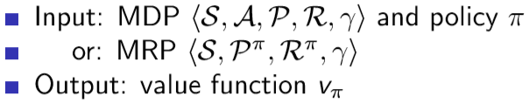
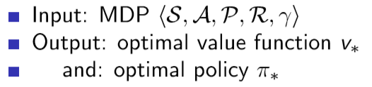
Introduction
What is Dynamic Programming?
Dynamic sequential or temporal component to the problem
Programming optimizing a “program”, i.e. a policy
A method for solving complex problems
By breaking them down into subproblems
Solve the subproblems
Combine solutions to subproblems
Planning by Dynamic Programming
Dynamic programming assumes full knowledge of the MDP
It is used for planning in an MDP
For prediction:
Or for Control:

Slide 4
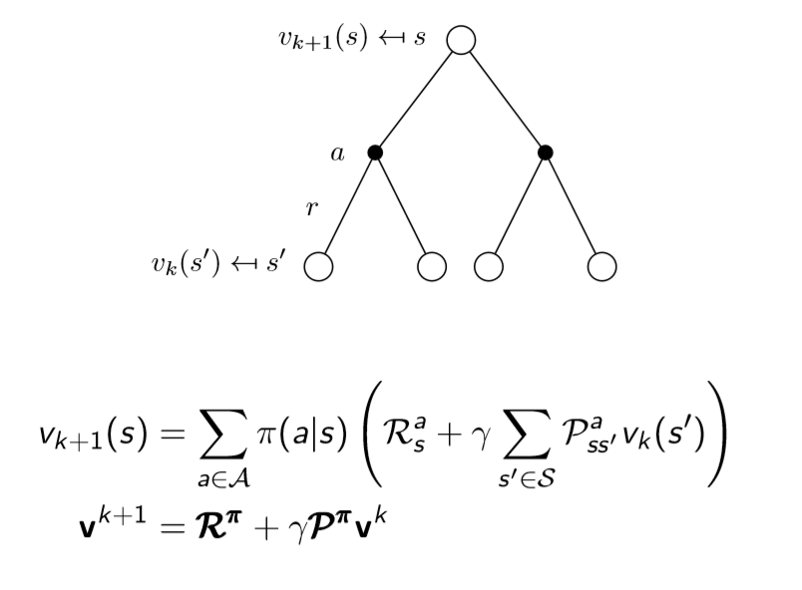
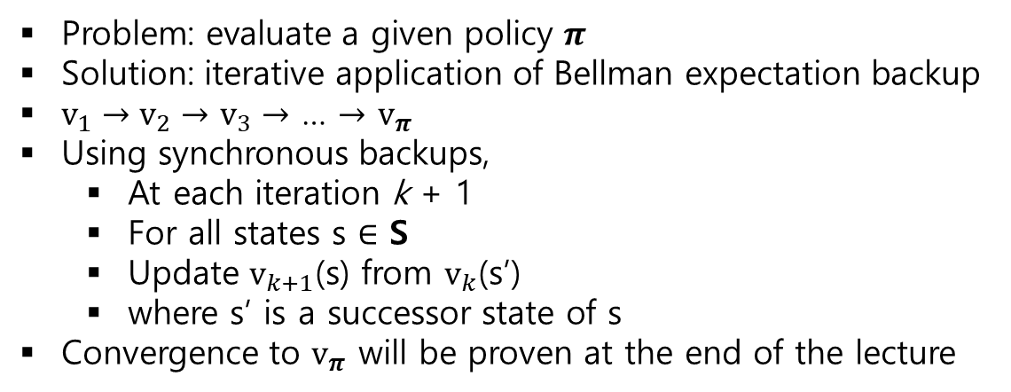
Policy Evaluation
Iterative Policy Evaluation
Problem: evaluate a given policy $π$
Solution: iterative application of Bellman expectation backup
$v_{1}→v_{2}→$ $v_{3}→$ … $→$ $v_{π}$
Using synchronous backups,
At each iteration k + 1
For all states s $∈$ S
Update $v_{k+1}$(s) from $v_{k}$(s’)
where s’ is a successor state of s
Convergence to $v_{π}$ will be proven at the end of the lecture

Slide 5
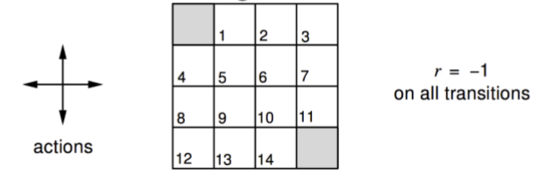

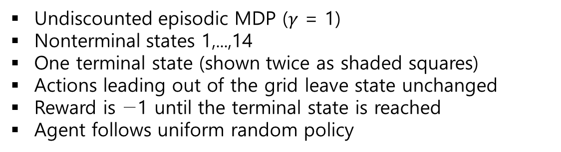
Policy Evaluation
Example : Evaluating a Random Policy in the Small Gridworld
Undiscounted episodic MDP ($γ$ = 1)
Nonterminal states 1,...,14
One terminal state (shown twice as shaded squares)
Actions leading out of the grid leave state unchanged
Reward is −1 until the terminal state is reached
Agent follows uniform random policy

Slide 6



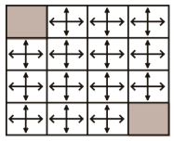
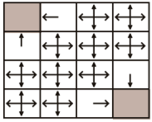




Policy Evaluation
Example : Evaluating a Random Policy in the Small Gridworld
0.0 | 0.0 | 0.0 | 0.0
0.0 | 0.0 | 0.0 | 0.0
0.0 | 0.0 | 0.0 | 0.0
0.0 | 0.0 | 0.0 | 0.0
${\text{v}}_{0}\left(s_{22}\right)=$ 0.0
$$k=0$$
Update
0.0 | -1.0 | -1.0 | -1.0
-1.0 | -1.0 | -1.0 | -1.0
-1.0 | -1.0 | -1.0 | -1.0
-1.0 | -1.0 | -1.0 | 0.0
${\text{v}}_{1}\left(s_{22}\right)=$ $\frac{1}{4} ×$ (-1 + 1 $×$ 1 $×$0 )
+ $\frac{1}{4} ×$ (-1 + 1 $×$ 1 $×$0 )
+ $\frac{1}{4} ×$ (-1 + 1 $×$ 1 $×$0 )
+ $\frac{1}{4} ×$ (-1 + 1 $×$ 1 $×$0 )
$=$ -1.0
$$k=1$$

Slide 7
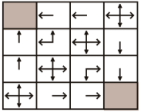




Policy Evaluation
Example : Evaluating a Random Policy in the Small Gridworld
0.0 | -1.0 | -1.0 | -1.0
-1.0 | -1.0 | -1.0 | -1.0
-1.0 | -1.0 | -1.0 | -1.0
-1.0 | -1.0 | -1.0 | 0.0
${\text{v}}_{1}\left(s_{12}\right)$ = -1.0
$$k=1$$
Update
0.0 | -1.75 | -2.0 | -2.0
-1.75 | -2.0 | -2.0 | -2.0
-2.0 | -2.0 | -2.0 | -1.75
-2.0 | -2.0 | -1.75 | 0.0
${\text{v}}_{2}\left(s_{12}\right)=$ $\frac{1}{4} ×$ (-1 + 1 $×$ 1 $×$ 0 )
+ $\frac{1}{4} ×$ (-1 + 1 $×$ 1 $×$ -1)
+ $\frac{1}{4} ×$ (-1 + 1 $×$ 1 $×$ -1)
+ $\frac{1}{4} ×$ (-1 + 1 $×$ 1 $×$ -1)
$=$ -1.75
$$k=2$$

Slide 8
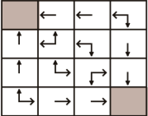

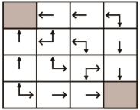




Policy Evaluation
Example : Evaluating a Random Policy in the Small Gridworld
0.0 | -2.4 | -2.9 | -3.0
-2.4 | -2.9 | -3.0 | -2.9
-2.9 | -3.0 | -2.9 | -2.4
-3.0 | -2.9 | -2.4 | 0.0
$$k=3$$
$$⋮$$
Update
Convergence to $v_{π}$
0.0 | -14 | -20 | -22
-14 | -18 | -20 | -20
-20 | -20 | -18 | -14
-22 | -20 | -14 | 0.0
$$k=∞$$

Slide 9


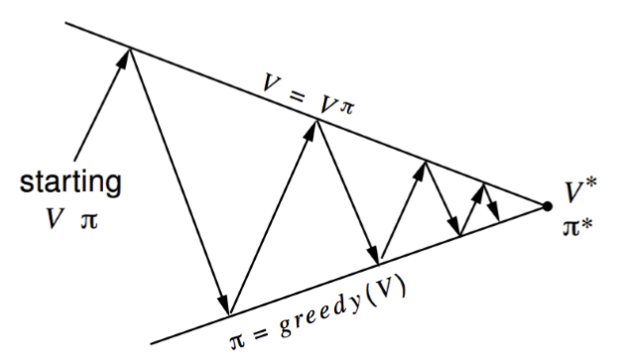
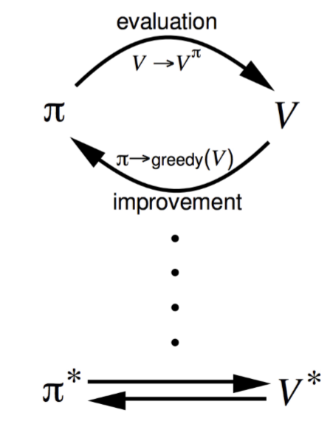
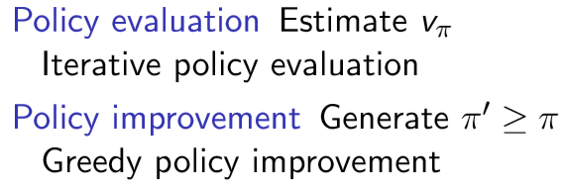
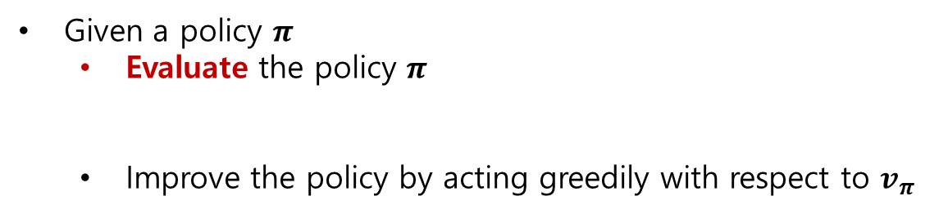
Policy Iteration
How to Improve a Policy
Given a policy $π$
Evaluate the policy $π$
Improve the policy by acting greedily with respect to $v_{π}$
In Small Gridworld improved policy was optimal, $π^{ ′}$= $π^{ ∗}$
In general, need more iterations of improvement / evaluation
But this process of policy iteration always converges to $π^{ ∗}$

Slide 10
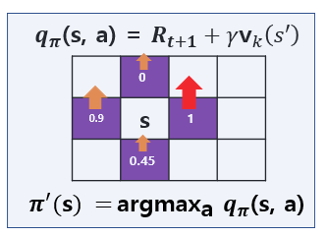

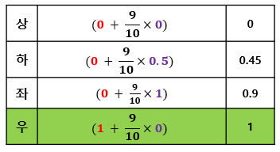
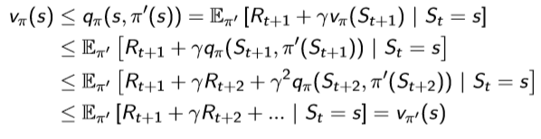
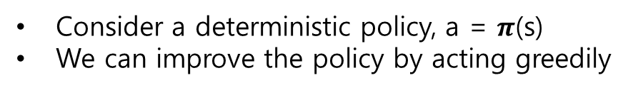
Policy Iteration
Policy Improvement (1)
Consider a deterministic policy, a = $π$(s)
We can improve the policy by acting greedily
탐욕 정책으로 얻은 새로운 정책 :
This improves the value from any state s over one step,
It therefore improves the value function, $v_{π^{ ′}}(s$) $≥$ $v_{π^{ }}(s\text{)}$

Slide 11

Policy Iteration
Policy Improvement (2)
If improvements stop,
Then the Bellman optimality equation has been satisﬁed
Therefore $v_{π^{ }}(s\text{)}$ = $v_{∗}(s\text{)}$ for all s ∈ S
so $π$ is an optimal policy
결론 : policy table을 update 함

Slide 12
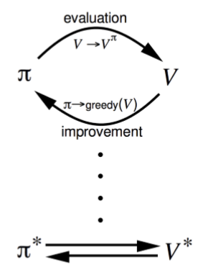
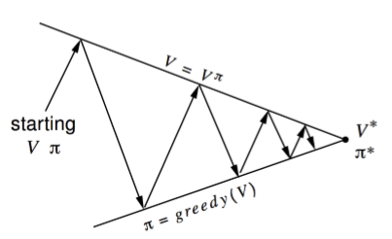
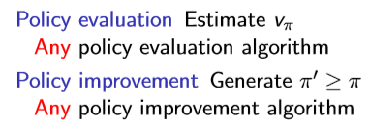
Policy Iteration
Generalized Policy Iteration

Slide 13
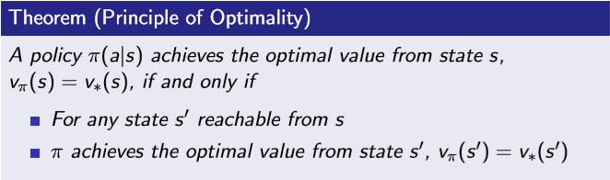
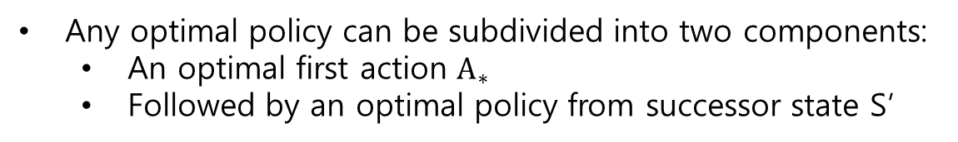
Value Iteration
Principle of Optimality
Any optimal policy can be subdivided into two components:
An optimal ﬁrst action $A_{∗}$
Followed by an optimal policy from successor state S’

Slide 14

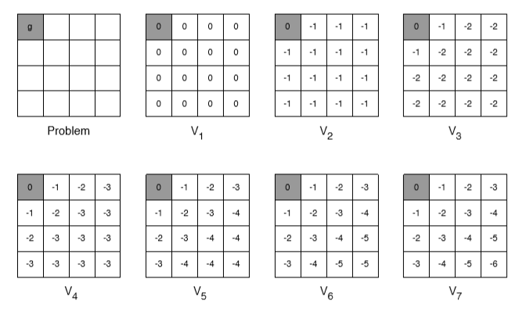
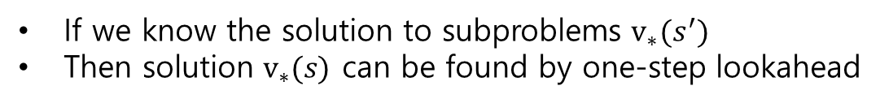
Value Iteration
Deterministic Value Iteration
If we know the solution to subproblems $v_{∗}(s^{′})$
Then solution $v_{∗}(s)$ can be found by one-step lookahead
The idea of value iteration is to apply these updates iteratively
Intuition: start with ﬁnal rewards and work backwards
Still works with loopy, stochastic MDPs
Example : Shortest Path

Slide 15
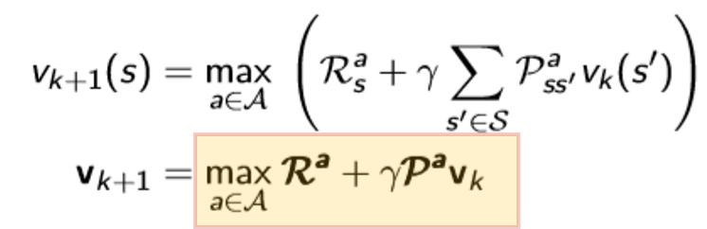

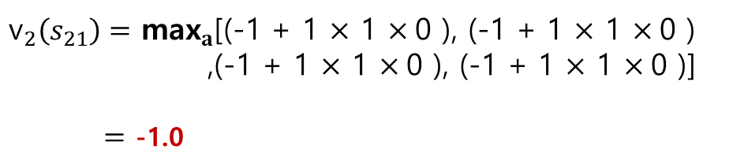
Value Iteration
Example : value function update in the Small Gridworld
0.0 | 0.0 | 0.0 | 0.0
0.0 | 0.0 | 0.0 | 0.0
0.0 | 0.0 | 0.0 | 0.0
0.0 | 0.0 | 0.0 | 0.0
${\text{v}}_{1}\left(s_{21}\right)=$ 0.0
$$k=1$$
Update
0.0 | -1.0 | -1.0 | -1.0
-1.0 | -1.0 | -1.0 | -1.0
-1.0 | -1.0 | -1.0 | -1.0
-1.0 | -1.0 | -1.0 | 0.0
${\text{v}}_{2}\left(s_{21}\right)=$ ${\text{max}}_{a}$[(-1 + 1 $×$ 1 $×$0 ), (-1 + 1 $×$ 1 $×$0 )
,(-1 + 1 $×$ 1 $×$0 ), (-1 + 1 $×$ 1 $×$0 )]
$=$ -1.0
$$k=2$$

Slide 16




Value Iteration
Example : value function update in the Small Gridworld
0.0 | -1.0 | -1.0 | -1.0
-1.0 | -1.0 | -1.0 | -1.0
-1.0 | -1.0 | -1.0 | -1.0
-1.0 | -1.0 | -1.0 | 0.0
${\text{v}}_{2}\left(s_{21}\right)=$ -1.0
$$k=2$$
Update
0.0 | -1.0 | -2.0 | -2.0
-1.0 | -2.0 | -2.0 | -2.0
-2.0 | -2.0 | -2.0 | -1.0
-2.0 | -2.0 | -1.0 | 0.0
${\text{v}}_{3}\left(s_{21}\right)=$ ${\text{max}}_{a}$[(-1 + 1 $×$ 1 $×$0 ), (-1 + 1 $×$ 1 $×$ -1 )
,(-1 + 1 $×$ 1 $×$ -1 ), (-1 + 1 $×$ 1 $×$ -1 )]
$=$ -1.0
$$k=3$$

Slide 17
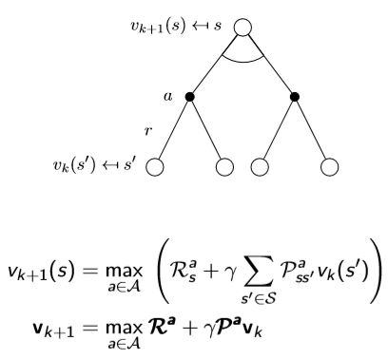
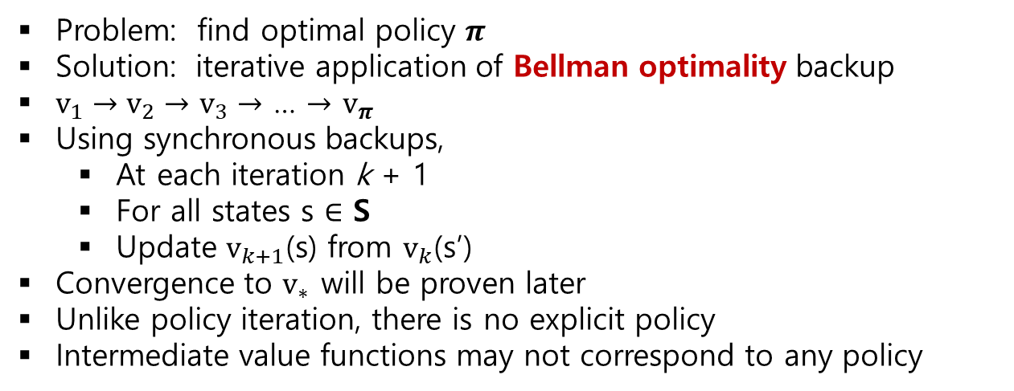
Value Iteration
Value Iteration
Problem: ﬁnd optimal policy $π$
Solution: iterative application of Bellman optimality backup
$v_{1}→v_{2}→$ $v_{3}→$ … $→$ $v_{π}$
Using synchronous backups,
At each iteration k + 1
For all states s $∈$ S
Update $v_{k+1}$(s) from $v_{k}$(s’)
Convergence to $v_{∗}$ will be proven later
Unlike policy iteration, there is no explicit policy
Intermediate value functions may not correspond to any policy
Policy Iteration
Value Iteration

Slide 18


The limitations of Dynamic Programming
Solving the Bellman Optimality Equation
Calculation Complexity
Curse of Dimension
Need complete information about the environment
O($n^{3})$
(x, y)
(x, y, z)
(x, y, z, …)
The number of S(states) increases exponentially !
$P_{ss ′}^{a}$ $R_{s}^{a}$
The model of the environment in MDP is state transition probability and reward.
Dynamic programming is not to learning, but to make calculations faster
Therefore, reinforcement learning is necessary.

